Slide 1
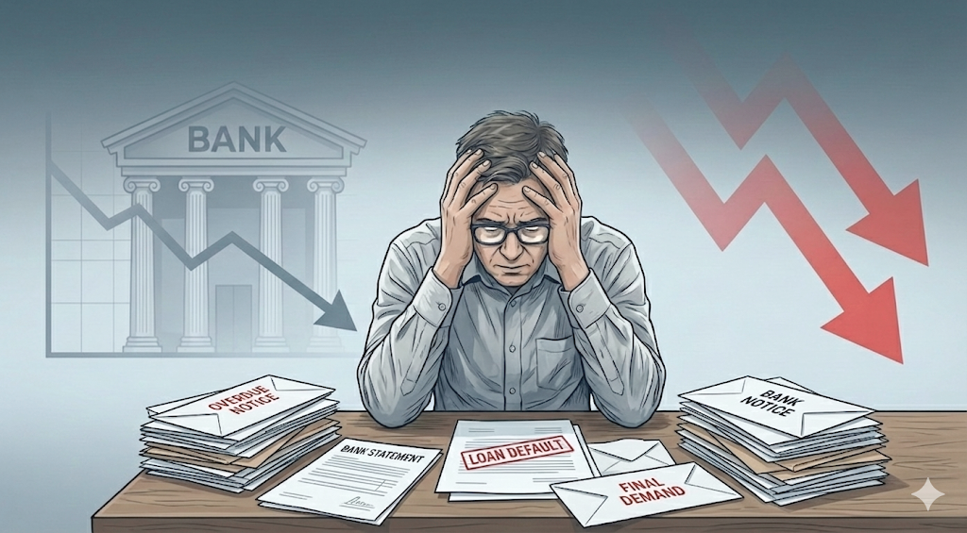




Loan Default
INSIDE LOAN DEFAULTS: RISK, PATTERNS, AND INSIGHTS

Slide 2


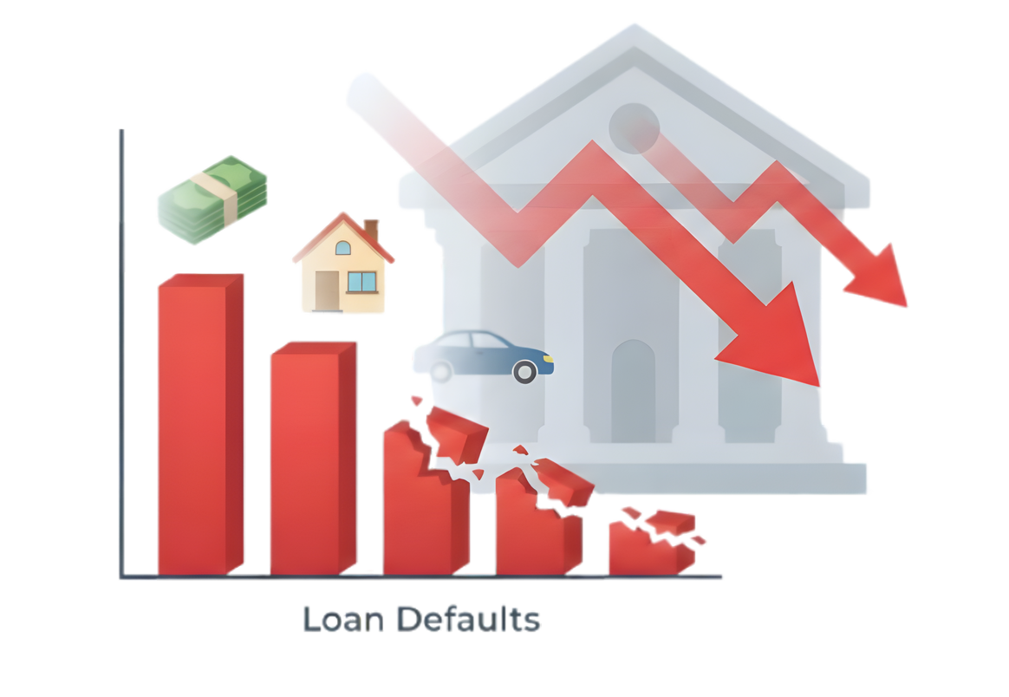
Did You Know?
Every year, thousands borrow to buy homes, cars, or study. But when repayments stop, banks suffer losses, and the economy slows down.
In 2023, Pakistani banks lost nearly Rs 995 billion, or roughly $3.5 billion, not by fraud but by everyday borrowers who couldn’t repay.
Sources: https://mettisglobal.news/bad-loans-surge-rs71bn-in-2023

Slide 3

Patterns Behind Loan Defaults
Banks lend money so people can buy cars, houses, or study.
But not everyone pays it back on time....
These people are called loan defaulters, meaning they failed to repay their loans as promised.
Our project studies who is most likely to default and why, so banks can spot risks early and reduce future losses.

Slide 4
Dataset Overview

Slide 5
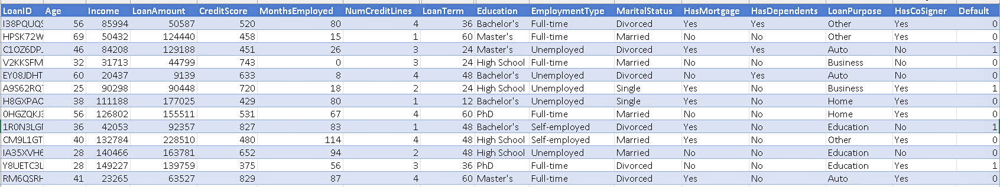
We Use:
Loan Default Prediction Dataset-Kaggle
The dataset contains: 255K Rows| 18 Columns
Sources: https://www.kaggle.com/datasets/nikhil1e9/loan-default

Slide 6
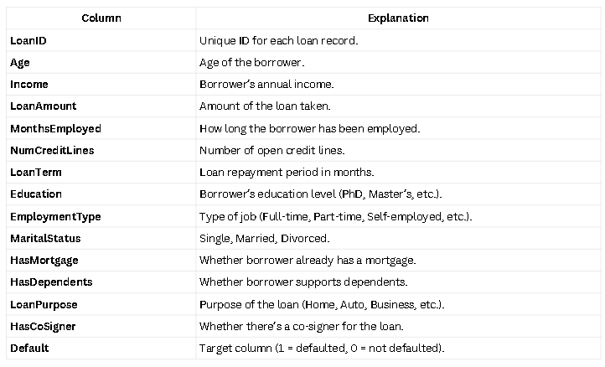
Sources: https://www.kaggle.com/datasets/nikhil1e9/loan-default

Slide 7
ANALYSIS

Slide 8
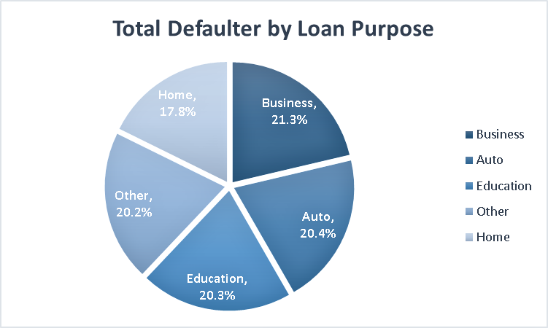
“Business and auto loans are riskiest”
Business and auto loans make up the largest share of defaults, about 21%, higher than home loans.

Slide 9
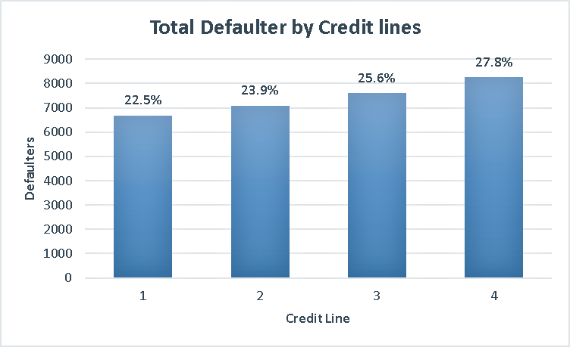
“More credit lines, more payment risk”
Defaults rise as credit lines increase, from 23% at one line to 28% at four lines.

Slide 10
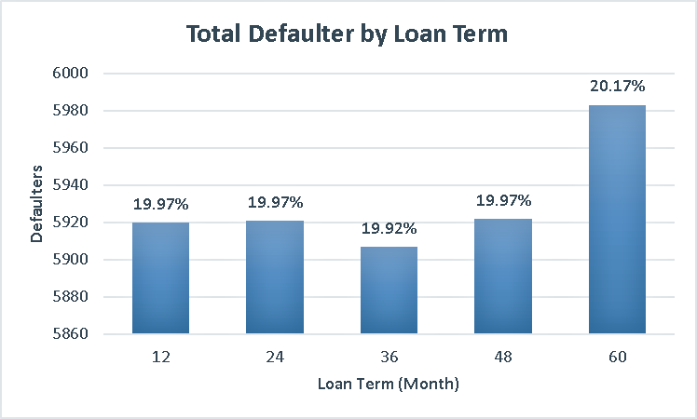
“Longer repayment, higher risk”
Defaults increase for longer loan terms, peaking near 60 months.

Slide 11
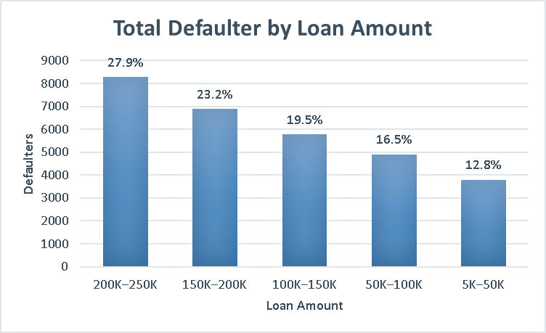
“Bigger loans, bigger risk”
Defaults rise sharply for larger loans, reaching nearly 28% for loans above 200K.

Slide 12
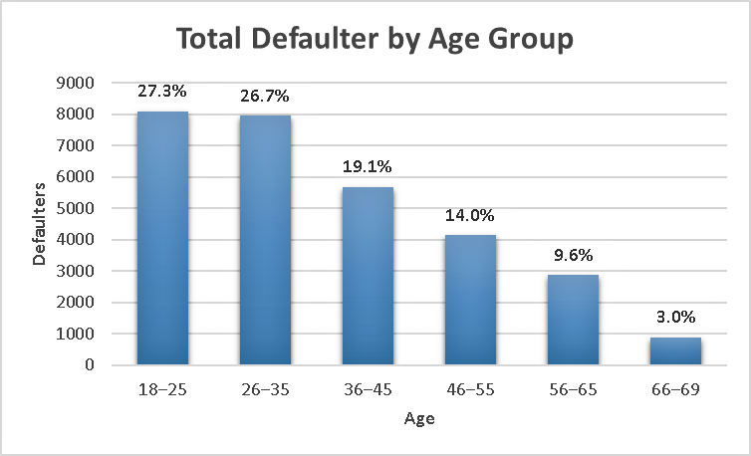
“Younger borrowers default more”
People under 35 default most, while older adults rarely miss payments.

Slide 13
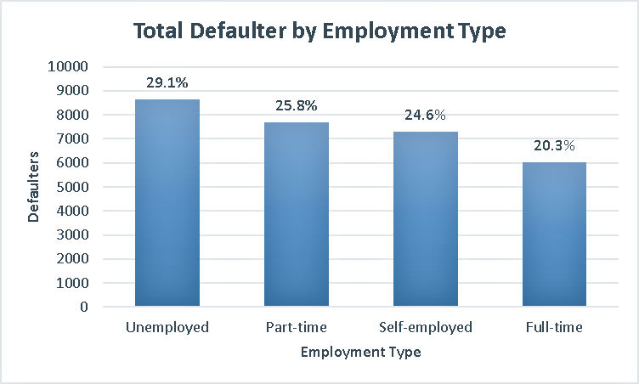
“Full-time workers default less”
Unemployed borrowers default 44% more than full-time employees

Slide 14
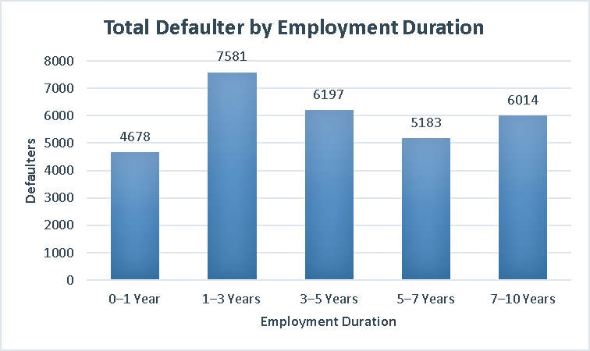
“Short-term jobs, higher risk”
Defaults are highest among borrowers with 1–3 years of work experience.

Slide 15
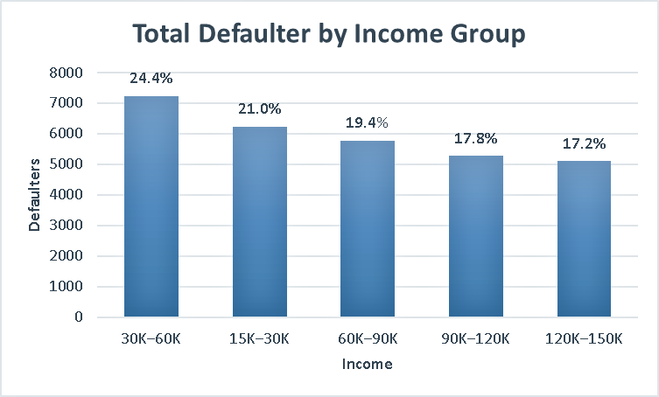
“Lower income, higher default chance”
Borrowers earning between 30K–60K show the highest default rate 24.4%.

Slide 16
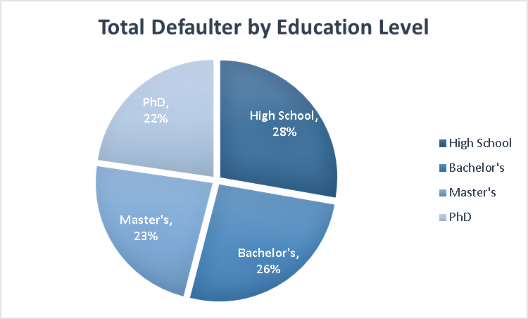
“Higher education, better repayment”
High school-educated borrowers default 28%, which is about 23% higher than PhD holders.

Slide 17
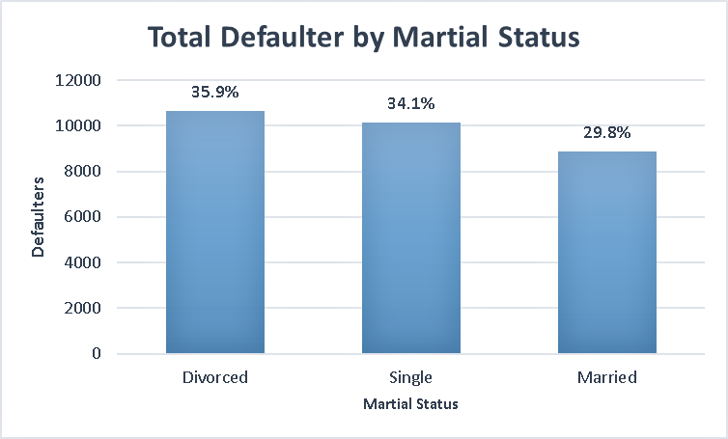
“Married borrowers repay better”
Divorced individuals default 20% more than married ones

Slide 18
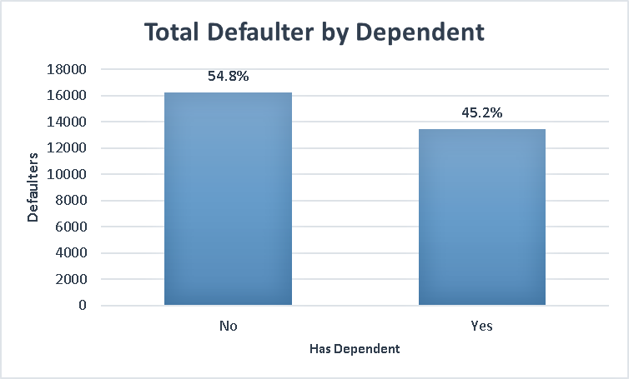
“No dependents, higher default”
People without dependents make up 55% of all defaulters

Slide 19
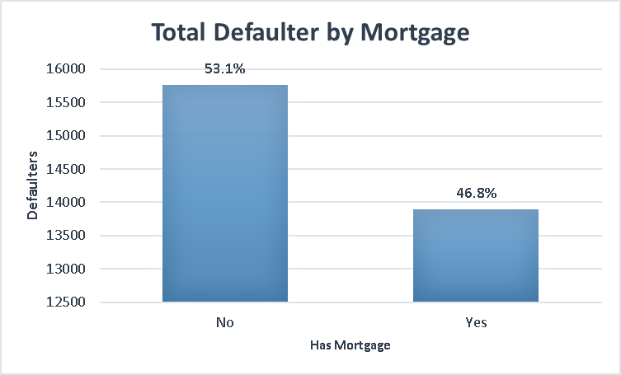
“Mortgage holders manage money better”
Those with mortgages default 47%, vs. 53% without

Slide 20

“Co-signers lower default risk”
Loans with a co-signer default 44%, lower than solo borrowers.

Slide 21
Finding & Suggestions

Slide 22

What We Found
Borrowers under 50 and those without dependents are more likely to default on their loans.
Defaults increase with more credit lines, showing higher risk among borrowers managing multiple accounts.
Business and Auto loans have the highest default rates, while Home loans remain the most stable.
Divorced and unemployed borrowers face the greatest repayment risk, while married and full-time workers are more reliable.
High school–educated borrowers show higher defaults than those with advanced education, highlighting the link between education and financial responsibility.
Lower-income borrowers (30K–60K) default most often, while higher earners (above 120K) default least.

Slide 23

What Banks Should Do
Tighten screening for high-risk applicants, especially younger borrowers and those without dependents.
Monitor customers with multiple credit lines and offer guidance to manage their debts better.
Apply stricter loan approval rules or higher interest buffers for Business and Auto loans, while keeping Home loans customer-friendly.
Track divorced and unemployed clients closely and provide repayment support options to reduce defaults.
Promote financial awareness programs for low-income or less-educated customers to improve repayment behavior.

Slide 24

Any Questions

Slide 25



Thank You

